Slide 1

Global Values
of Functions of Several Variables

Slide 2
最值应用问题
函数 f 在有界闭集上连续
依据
函数 f 在有界闭集上可达最值
Critical points
最值可疑点
边界上的最点
特别, 当区域内部最值存在, 且只有一个极值
点P 时,
f(P)为极小值
f(P)为最小值
(大)
(大)

Slide 3


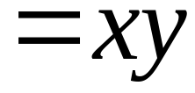
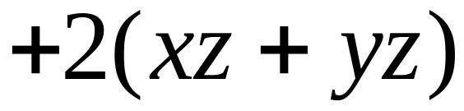
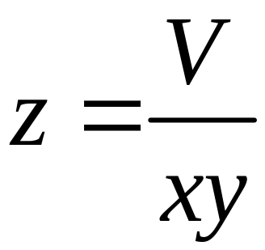

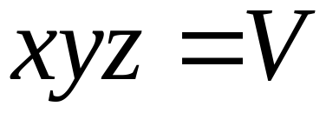

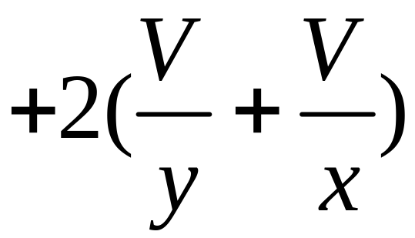


Slide 4
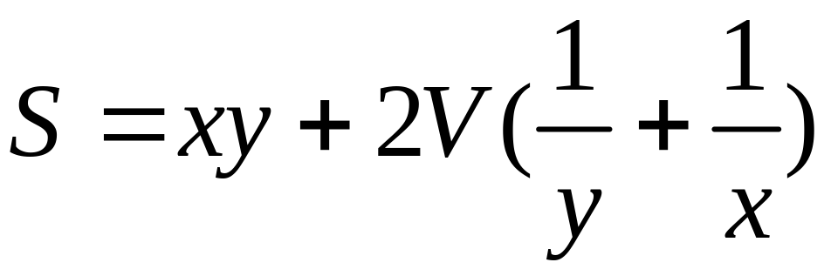
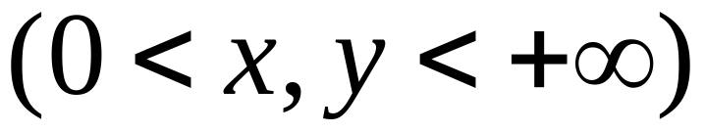
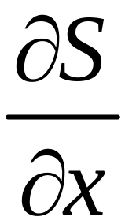
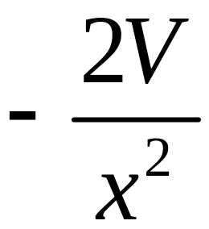

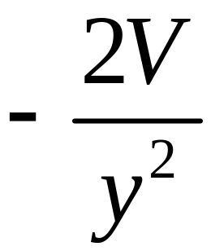
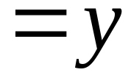
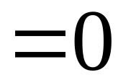

目标函数
定义域是开区域
好消息！
最值将在区域内部取到 ?
求驻点

Slide 5
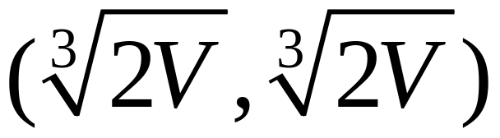
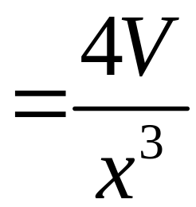
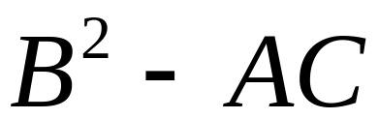
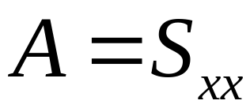


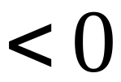
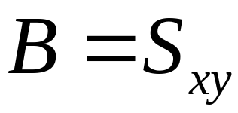


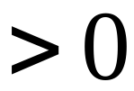
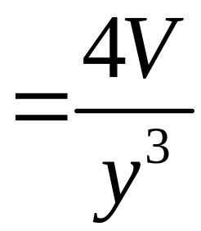
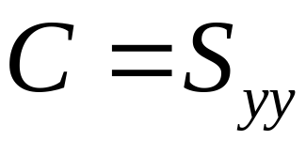
得驻点：
S 取得极小值

Slide 6
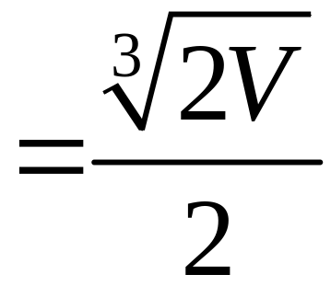
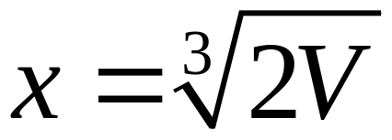
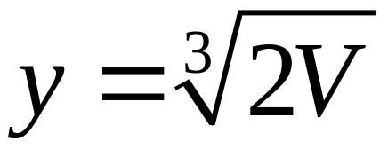
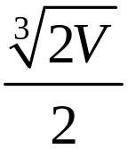

当
时
材料最省

Slide 7
Candidates？
1. Critical points
2. Boundary points
Theorem
A continuous function on a closed field must attain its global maximum and global minimum at some points, either interior points or boundary points

Slide 8
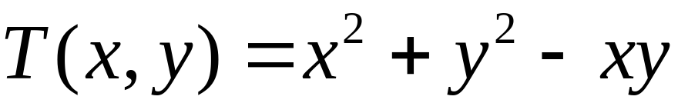
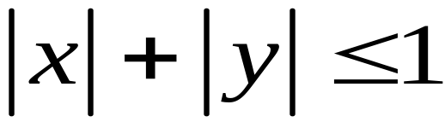


Example
Find absolute extrema of
a square
On the domain：
This is a closed field

Slide 9
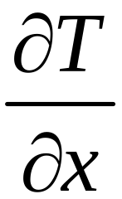
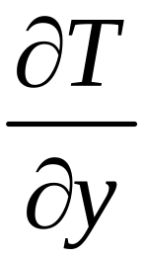

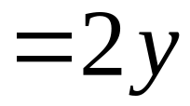


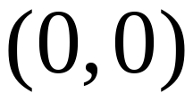
(1) Find critical points
Only one critical point, which is also a stationary point

Slide 10




(2) Find candidates on the boundary

Slide 11

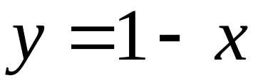
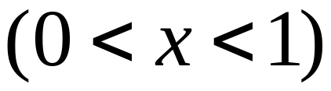
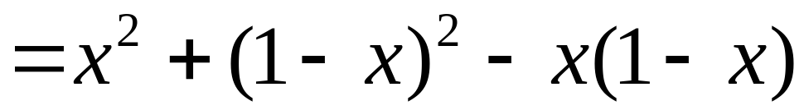
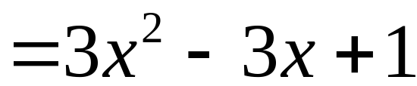
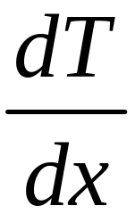
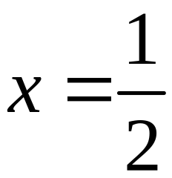

For the side AB：
Stationary point
And of course ,the End points AB

Slide 12
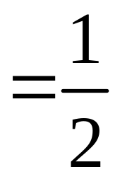
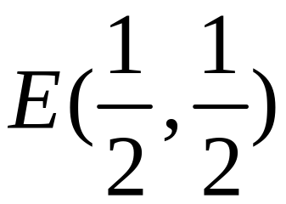




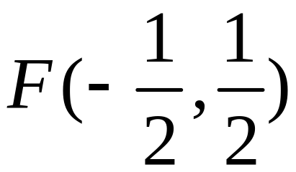
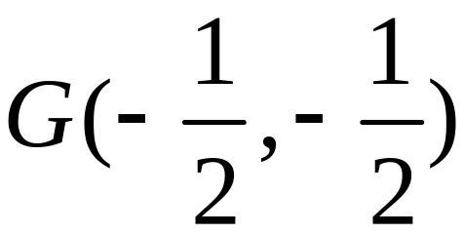
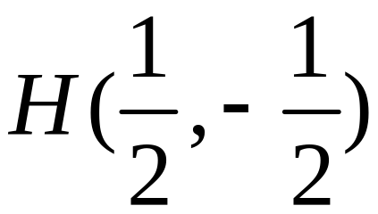
Similarly, we can obtain C, D and

Slide 13
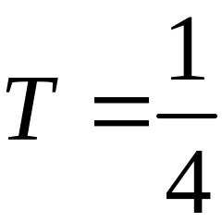
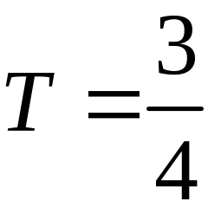
Evaluate T at those points
O:
minimum
T = 0
A, B, C, D:
maximum
T = 1
E, G:
F, H:
Maximum at A, B, C, D
Minimum at O

Slide 14
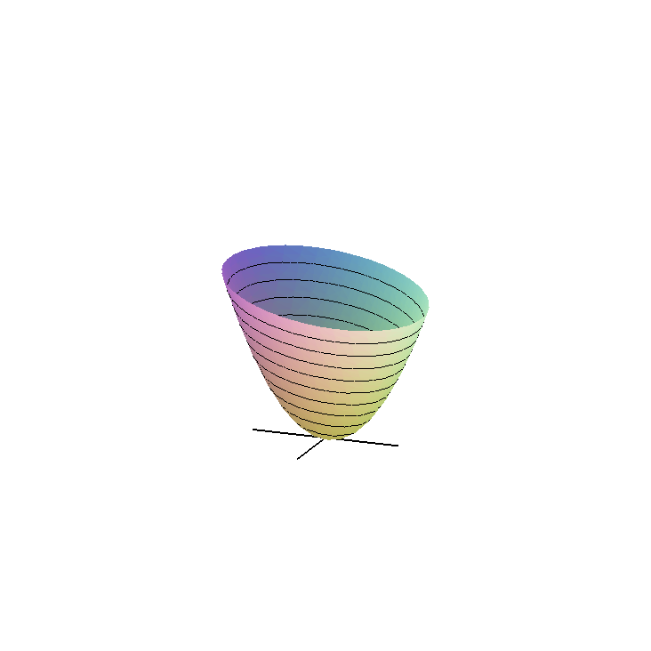
with(plots):
qumian:=implicitplot3d(x^2+y^2-x*y=z,x=-2..2,y=-2..2,z=0..2,style=patchcontour,contours=15,numpoints=10000):
x_axis:=plot3d([u,0,0],u=-1..1,v=0..0.01,thickness=2):
y_axis:=plot3d([0,u,0],u=-1..1,v=0..0.01,thickness=2):
z_axis:=plot3d([0,0,u],u=0..3,v=0..0.01,thickness=2):
display(qumian,x_axis,y_axis, z_axis,orientation=[23,66],scaling=constrained);

Slide 15
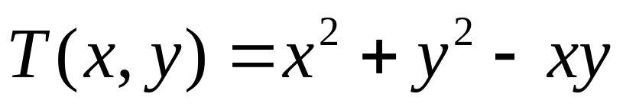
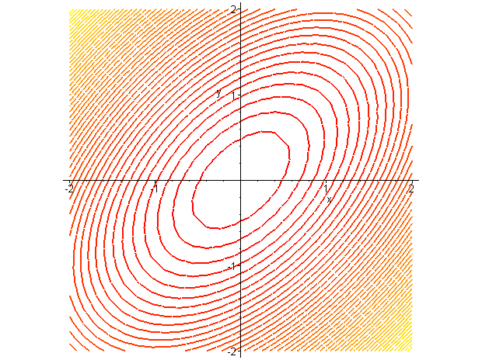
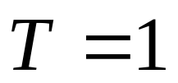
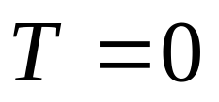
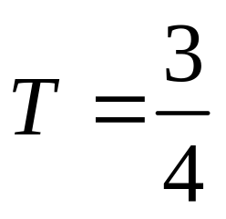

6.6多元函数的极值
温度场
等温线
contourplot(x^2+y^2-x*y,x=-2..2,y=-2..2,contours=50,thickness=2);

Slide 16

with(plots):
p1:=implicitplot(x^2+y^2-x*y=1,x=-2..2,y=-2..2,scaling=constrained,color=blue,numpoints=10000,thickness=3):
p2:=implicitplot(x^2+y^2-x*y=3/4,x=-2..2,y=-2..2,scaling=constrained,color=green,numpoints=10000,thickness=3):
p3:=implicitplot(x^2+y^2-x*y=1/4,x=-2..2,y=-2..2,scaling=constrained,color=brown,numpoints=10000,thickness=3):
display(p1,p2,p3);

Slide 17
END

